Slide 1


STATUS REPORT
Indoor Drone

Slide 2
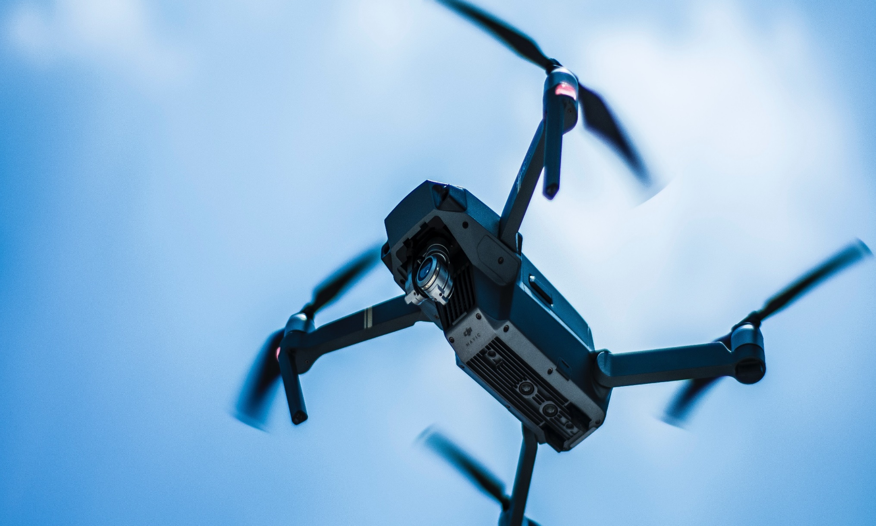
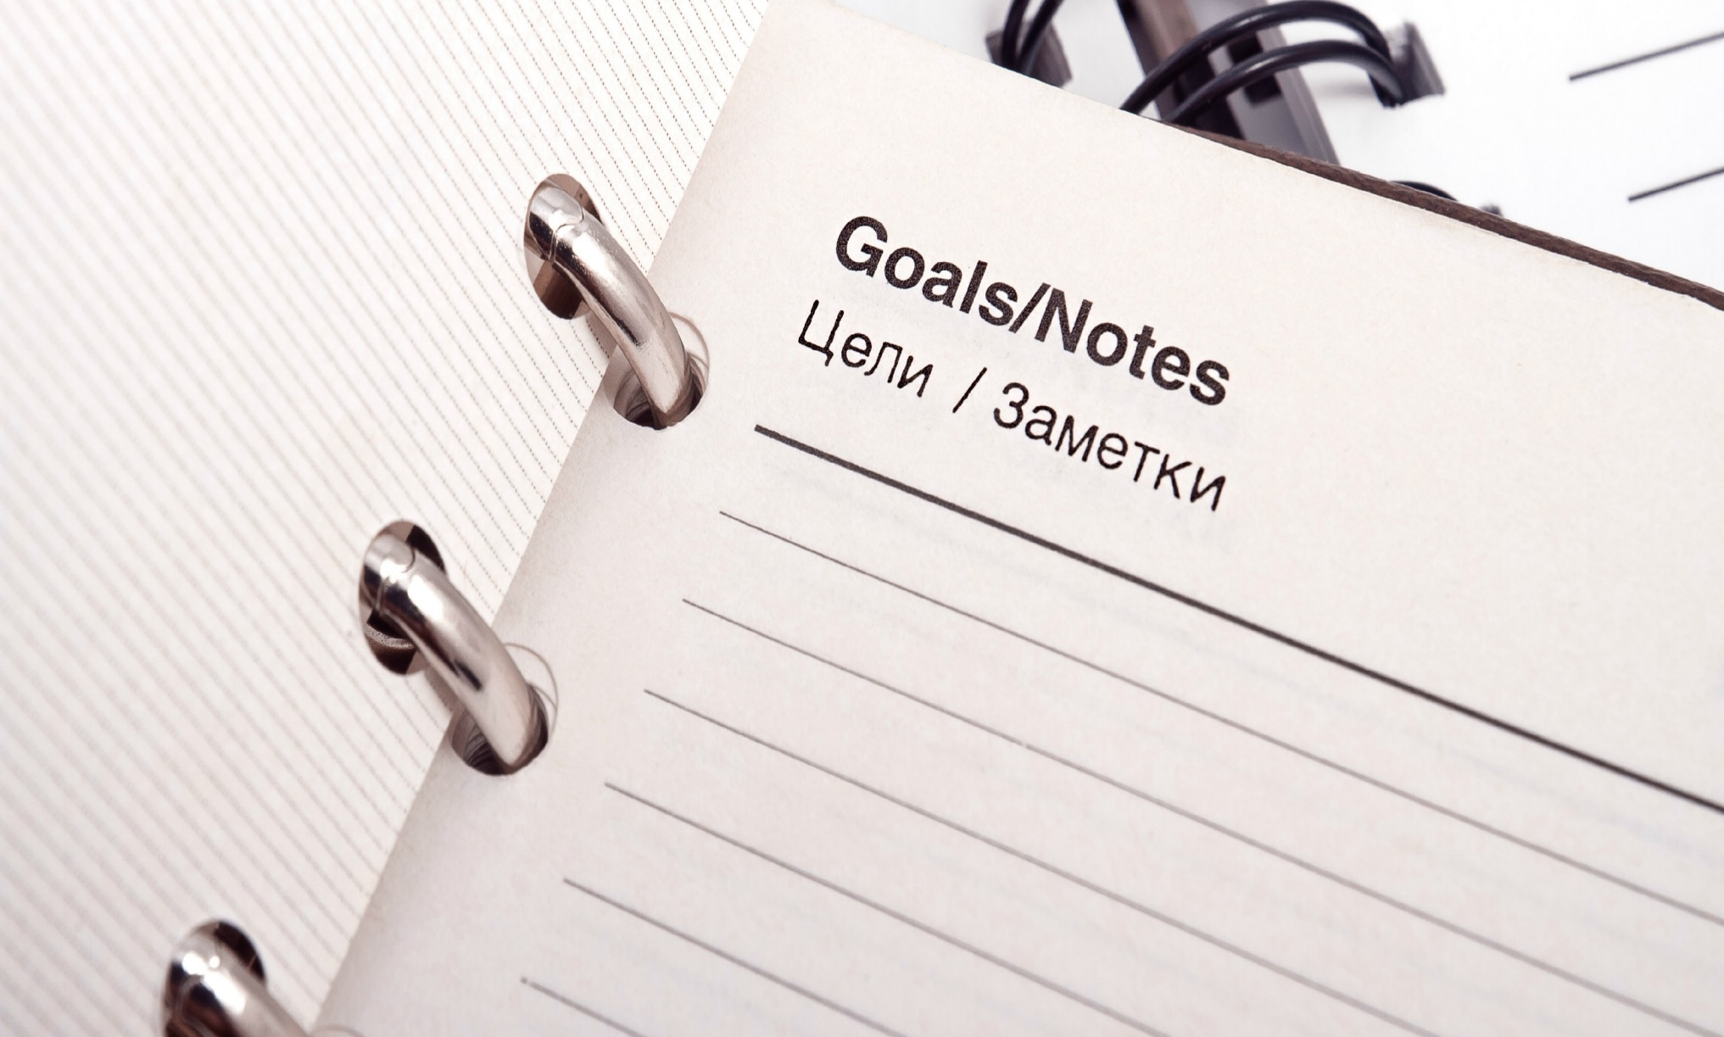
Project Stages
Progress
Finish soldering electrical parts
Created a simulated environment
Basic function commands
Assembled Drone version 2
Test-cases performed on the simulated drone

Slide 3
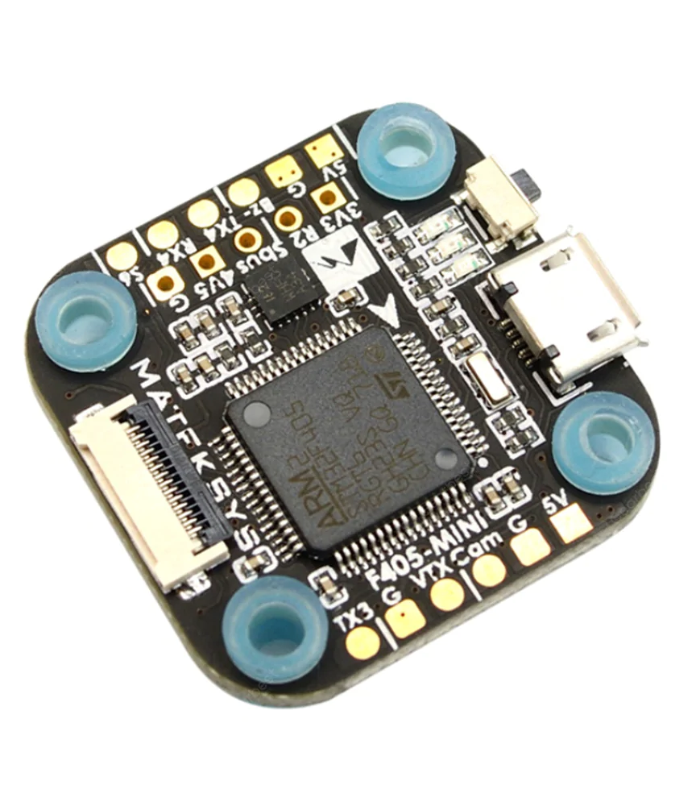
Drone version 1
Matek F405-mini
Stuff in here
What we did no1
Why we need matek
Reasons
Reasons
No need to fill everything!

Slide 4

Challenges with matek setup
List delays and problems since last status update was given
Make sure you understand
Issues that are causing delays or impending progress
Why problem was not anticipated
If customer will want to discuss issue with upper management
List corrective actions being taken
Address schedule implications

Slide 5
Drone version 2
Contents Title
You can simply impress your audience and add a unique zing and appeal to your Presentations.
Simple
Presentation
You can simply impress your audience and add a unique zing and appeal to your Presentations. Easy to change colors, photos and Text. Get a modern PowerPoint Presentation that is beautifully designed
Contents
Title
Contents Title
You can simply impress your audience and add a unique zing and appeal to your Presentations.

Slide 6

Progress
List achievements and progress since last status update was given
Highlight those things that made progress possible
Address schedule implications

Slide 7

Schedule
List top high-level dates
Distribute more detailed schedule if appropriate
Keep simple so audience does not get distracted with details
Make sure you are familiar with details of schedule so you can answer questions

Slide 8

Deliveries
List main critical deliverables
Understand your confidence rating to each deliverable
Yours to client
Yours to outside services
Outside services to you
Other departments to you
Indicate confidence level on slides if appropriate

Slide 9

Costs
List new projections of costs
If there are cost overruns
Include original estimates
Understand source of differences in these numbers – be ready for questions
Summarize why
List corrective or preventative action you’ve taken
Set realistic expectations for future expenditures

Slide 10

Technology
List technical problems that have been solved
List any dubious technological dependencies for project
Indicate source of doubt
Summarize action being taken or back up plan
List outstanding technical issues that need to be solved
Summarize their impact on the project

Slide 11

Resources
Summarize project resources
Understand that customers may want to be assured that all possible resources are being used, but in such a way that costs will be properly managed
Dedicated (full-time) resources
Part-time resources
If project is constrained by lack of resources, suggest alternatives

Slide 12

Goals for Next Review
Date of next status update
Make sure anyone involved in project understands action plan
List goals for next review
Specific items that will be done
Issues that will be resolved

